Slide 1
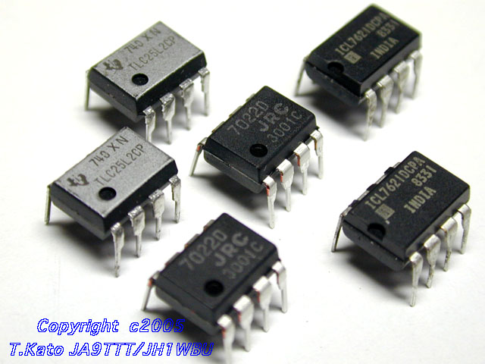
Operational Amplifiers

Slide 2
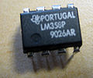




Op-Amp – The Surface
An Operational Amplifier (Op-Amp) is an integrated circuit that uses external voltage to amplify the input through a very high gain.
We recognize an Op-Amp as a mass-produced component found in countless electronics.
Fig (1) OPAMP IC and Pin Configuration

Slide 3
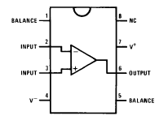
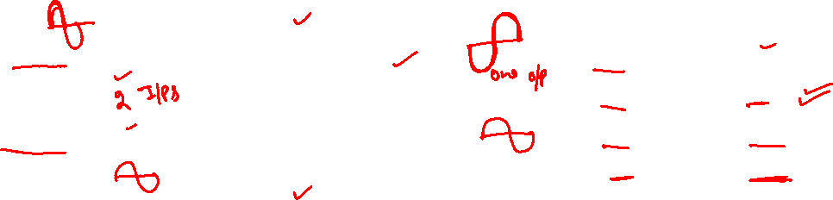
What is an Op-Amp? – The Inside
Op-amps (amplifiers/buffers in general) are drawn as a triangle in a circuit schematic
The actual count varies, but an Op-Amp contains several Transistors, Resistors, and a few Capacitors and Diodes.
For simplicity, an Op-Amp is often depicted as follows which has minimum of five terminals such as inverting input, non inverting input ,power supply and an output.
divot on pin-1 end
Positive Power Supply
Inverting Input
Output
Non-Inverting Input
Negative Power Supply

Slide 4
Basic Block Diagram of Op-Amp
An Op-Amp can be conveniently divided in to four main blocks
An Input Stage or Input Diff. Amp.
The Gain Stage
The Level Translator
An Out put Stage
V₁
Out put Stage (Buffer)
Input Stage
(Diff. Amp.)
Gain Stage (C E Amp.)
Level Shifter
I/P
V_{O}
V₂
Op-Amp IC

Slide 5
Basic Block Diagram of Op-Amp
A Differential Amplifier i.e, it is the input stage for the op-amp. It provides the amplification of the difference voltage b/w the two inputs.
A Voltage Amplifier(s) i.e, it is the second stage of op-amp

Slide 6
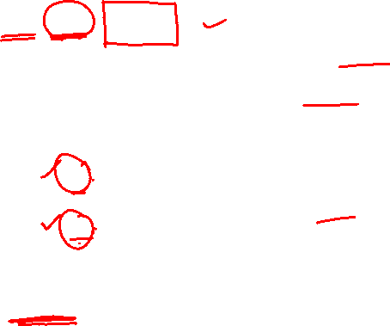
Basic Block Diagram of Op-Amp
The internal op-amp formula is:
V_{out} = gain×(V₊ − V₋)
So if V₊ is greater than V₋, the output goes positive
If V₋ is greater than V₊, the output goes negative
A gain of 200,000 makes this device (as illustrated here) practically useless
V₋
−
V_{out}
V₊
+

Slide 7
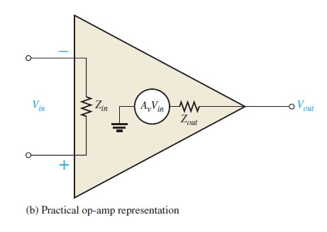

Ideal Op-Amp
The Ideal Op-Amp
It has infinite voltage gain and infinite bandwidth.
It has infinite input impedance (open) so that it does not load the driving source.
It has zero output impedance.
These characteristics are illustrated in figure. The input voltage ,V_{in} , appears b/w the two terminals, and the output voltage is A_{v}V_{in} , as indicated by the internal voltage source symbol.

Slide 8
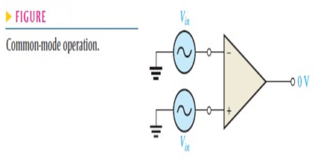
Op-Amp Parameters
Common Mode
Two signal voltages of the same phase, frequency and amplitude are applied to the two inputs as shown is given in below figure.
This results in a zero output voltage (as difference is 0V).
This action is called common-mode rejection.

Slide 9


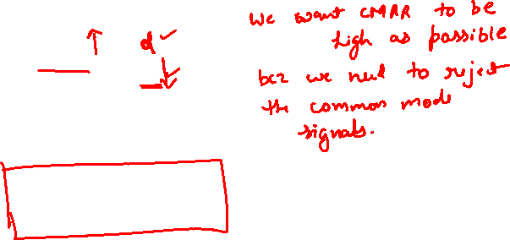
Op-Amp Parameters
CMRR (COMMON MODE REJECTION RATIO):
Desired signals can appear on only one input or with opposite polarities on both input lines. These desired signals are amplified and appear on the output.
Unwanted signals (noise) appearing with the same polarity on both input lines are essentially cancelled by the op-amp and don’t appear on the output. The measure of an amplifier’s ability to reject common-mode signals is a parameter called the CMRR (Common-Mode Rejection Ratio).
The CMRR is often expresses in decibels (dB) as

Slide 10
Op-Amp Parameters
INPUT OFFSET VOLTAGE
Ideal op-amp produces zero volts out for zero volts in.
However, in op-amp a small dc voltage, V_{OUT(error)} , appears at the output when no differential input voltage is applied. Its primary cause is a slight mismatch of the base-emitter voltages of the differential amplifier input stage of an op-amp.
Input offset voltage, V_{OS} ,is the differential dc voltage required between the inputs to force the output to zero volts.
Typical values of input offset voltage are in the range of 2mV or less. It is 0V in ideal case.

Slide 11
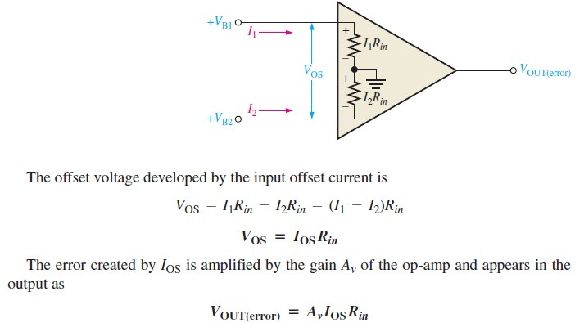
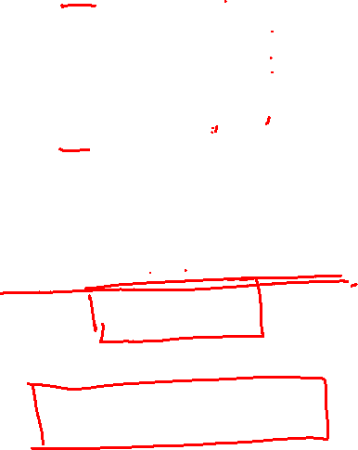
Op-Amp Parameters
INPUT OFFSET VOLTAGE

Slide 12

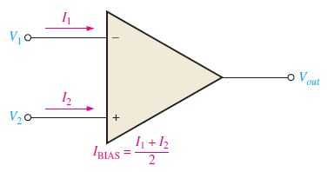

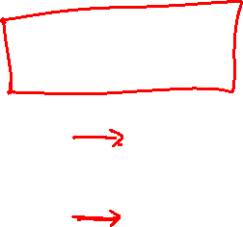
Op-Amp Parameters
INPUT BIAS CURRENT
Input terminals of a differential amplifier are the transistor bases and therefore , the input currents are the base currents as shown in the figure.

Slide 13


Op-Amp Parameters
INPUT OFFSET CURRENT
Ideally, the two input bias currents are equal and thus their difference is zero.
However, in a practical op-amp, the bias currents are not exactly equal.
The input offset current , I_{OS} is the difference of the input bias currents expressed as an absolute value.

Slide 14
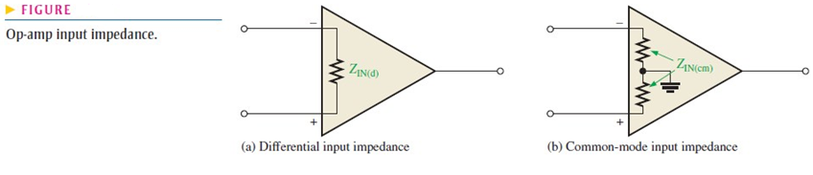
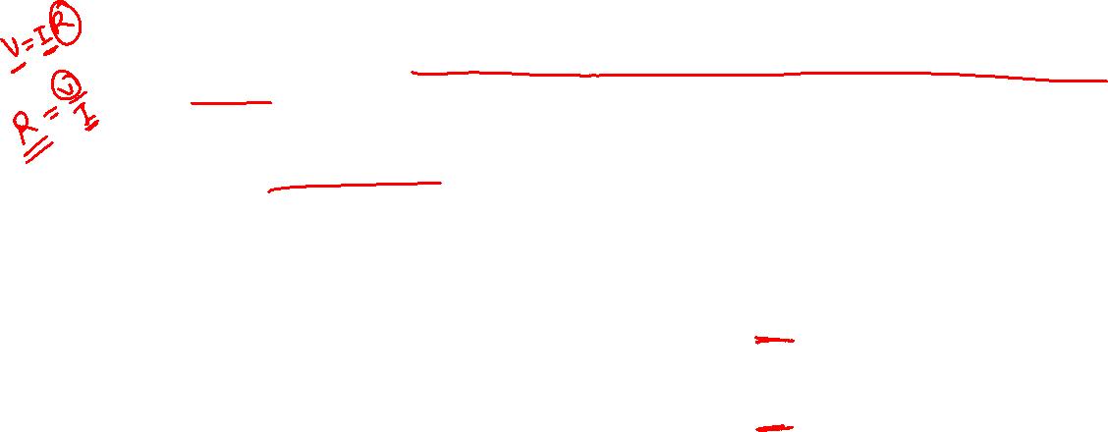
Op-Amp Parameters
INPUT IMPEDANCE
The Differential input impedance is the total resistance between the inverting and non-inverting terminals as illustrated in figure (a). Differential impedance is measured by determining the change in bias current for a given change in differential input voltage.
The common-mode input impedance is the resistance between each input and ground and is measured by determining the change in bias current for a given change in common-mode input voltage shown in figure.

Slide 15
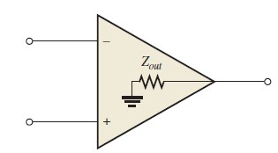
Op-Amp Parameters
OUTPUT IMPEDANCE
The output impedance is the resistance viewed from the output terminal of the op-amp as shown in figure below

Slide 16
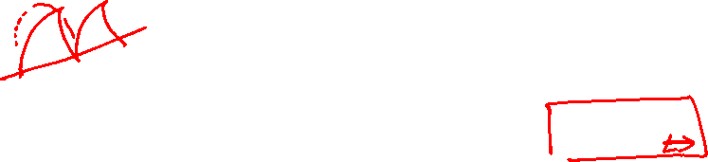
Op-Amp Parameters
Slew Rate
The slew rate (SR) of an op-amp is the maximum rate at which the output voltage can change in response to input voltage.
When the SR is too slow for the input, distortion results.
For example when an input sine wave is applied to a voltage follower it produces a triangular output waveform.
The triangular waveform results because the op-amp simply cannot move fast enough to follow the sine wave input.
This happens because voltage change in the second stage ( Voltage Amplifier(s) ) is limited by the charging and discharging of capacitors.
The slew rate is expressed as :
SR = ∆V_{O}/∆t
The unit of SR is volts per microseconds.

Slide 17
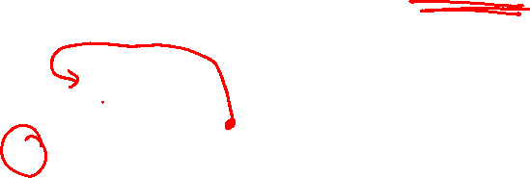
Infinite Gain in negative feedback
Infinite gain would be useless except in the self-regulated negative feedback regime
negative feedback seems bad, and positive good—but in electronics positive feedback means runaway or oscillation, and negative feedback leads to stability
Imagine hooking the output to the inverting terminal:
If the output is less than V_{in}, it shoots positive
If the output is greater than V_{in}, it shoots negative
result is that output quickly forces itself to be exactly V_{in}
−
negative feedback loop
V_{in}
+

Slide 18
Even under load
Even if we load the output (which as pictured wants to drag the output to ground)…
the op-amp will do everything it can within its current limitations to drive the output until the inverting input reaches V_{in}
negative feedback makes it self-correcting
in this case, the op-amp drives (or pulls, if V_{in} is negative) a current through the load until the output equals V_{in}
so what we have here is a buffer: can apply V_{in} to a load without burdening the source of V_{in} with any current!
−
Important note: op-amp output terminal
sources/sinks current at will: not like
inputs that have no current flow
V_{in}
+

Slide 19
Positive feedback pathology
In the configuration below, if the + input is even a smidge higher than V_{in}, the output goes way positive
This makes the + terminal even more positive than V_{in}, making the situation worse
This system will immediately “rail” at the supply voltage
could rail either direction, depending on initial offset
−
V_{in}
+
positive feedback: BAD

Slide 20
Op-Amp “Golden Rules”
When an op-amp is configured in any negative-feedback arrangement, it will obey the following two rules:
The inputs to the op-amp draw or source no current (true whether negative feedback or not)
The op-amp output will do whatever it can (within its limitations) to make the voltage difference between the two inputs zero

Slide 21
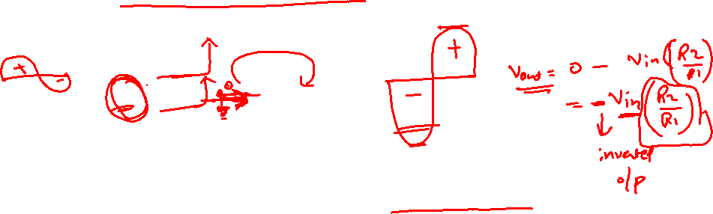
Inverting amplifier example
R₂
R₁
V_{in}
−
V_{out}
+
Applying the rules: − terminal at “virtual ground”
so current through R₁ is I_{f} = V_{in}/R₁
Current does not flow into op-amp (one of our rules)
so the current through R₁ must go through R₂
voltage drop across R₂ is then I_{f}R₂ = V_{in}×(R₂/R₁)
So V_{out} = 0 − V_{in}×(R₂/R₁) = −V_{in}×(R₂/R₁)
Thus we amplify V_{in} by factor −R₂/R₁
negative sign earns title “inverting” amplifier
Current is drawn into op-amp output terminal

Slide 22
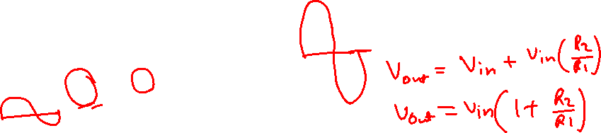
Non-inverting Amplifier
R₂
R₁
−
V_{out}
V_{in}
+
Now neg. terminal held at V_{in}
so current through R₁ is I_{f} = V_{in}/R₁ (to left, into ground)
This current cannot come from op-amp input
so comes through R₂ (delivered from op-amp output)
voltage drop across R₂ is I_{f}R₂ = V_{in}×(R₂/R₁)
so that output is higher than neg. input terminal by V_{in}×(R₂/R₁)
V_{out} = V_{in} + V_{in}×(R₂/R₁) = V_{in}×(1 + R₂/R₁)
thus gain is (1 + R₂/R₁), and is positive
Current is sourced from op-amp output in this example

Slide 23
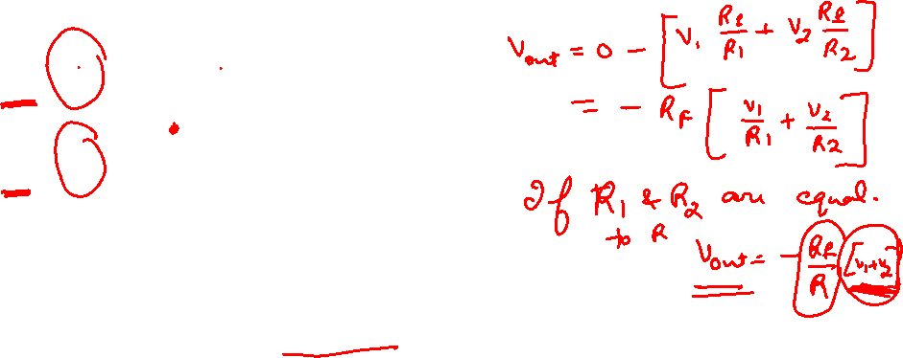
Summing Amplifier
R_{f}
R₁
V₁
−
R₂
V_{out}
V₂
+
Much like the inverting amplifier, but with two input voltages
inverting input still held at virtual ground
I₁ and I₂ are added together to run through R_{f}
so we get the (inverted) sum: V_{out} = −R_{f}×(V₁/R₁ + V₂/R₂)
if R₂ = R₁, we get a sum proportional to (V₁ + V₂)
Can have any number of summing inputs
we’ll make our D/A converter this way

Slide 24
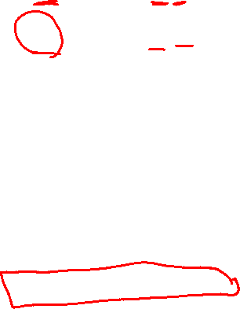
Differencing Amplifier
R₂
R₁
V⁻
−
V_{out}
V⁺
+
R₁
R₂
The non-inverting input is a simple voltage divider:
V_{node} = V⁺R₂/(R₁ + R₂)
So I_{f} = (V⁻ − V_{node})/R₁
V_{out} = V_{node} − I_{f}R₂ = V⁺(1 + R₂/R₁)(R₂/(R₁ + R₂)) − V⁻(R₂/R₁)
so V_{out} = (R₂/R₁)(V⁺ − V⁻)
therefore we difference V⁺ and V⁻

Slide 25
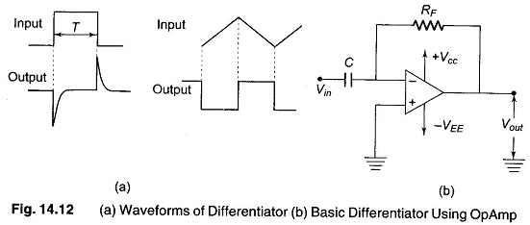













Differentiator (high-pass)
R
C
V_{in}
−
V_{out}
+
For a capacitor, Q = CV, so I_{cap} = dQ/dt = C·dV/dt
Thus V_{out} = −I_{cap}R = −RC·dV/dt
So we have a differentiator, or high-pass filter
if signal is V₀sinωt, V_{out} = −V₀RCωcosωt
the ω-dependence means higher frequencies amplified more

Slide 26
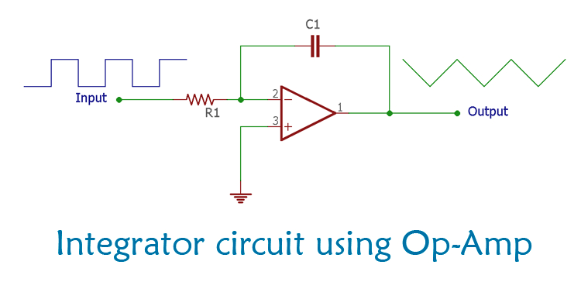















Low-pass filter (integrator)
C
R
V_{in}
−
V_{out}
+
I_{f} = V_{in}/R, so C·dV_{cap}/dt = V_{in}/R
and since left side of capacitor is at virtual ground:
−dV_{out}/dt = V_{in}/RC
so
and therefore we have an integrator (low pass)

Slide 27



















Slide 28


































Slide 29




















































Slide 30

























Slide 31

































Slide 32











Slide 33


















